Slide 1



Lecture 8 ARM interrupts and Interrupt-Driven Ping-Pong
References on Interrupts
Exceptions, Interrupts, Vector Table, Handlers
Level 1, 2 and 3 Interrupt Configurations
interrupt_counter_tut_2D.c
AXI GPIO Core and Interrupt
AXI Timer and Interrupt
Lab #7 Interrupt-Driven LED Ping-Pong Game on Zybo

Slide 2
References on Interrupts
How to Use Interrupts on the Zynq SoC, Xcell Journal 87
ARM® Generic Interrupt Controller, Architecture version 2.0, Architecture Specification, 2013
Chapter 3 Interrupt Controller, Cortex™-A9 MPCore Revision: r2p2, Technical Reference Manual, ARM DDI 0407F
General purpose I/O (XGpio) device drivers, gpio v4_0, Xilinx.
xil_exception.c,standalone_v4_2, from C:\Xilinx\SDK\2014.4\data\embeddedsw\lib\bsp\standalone_v4_2\src\cortexa9
The Zynq Book Tutorials, v1.2 - September 2014, University of Strathclyde, Glasgow, Scotland, UK
Altera: Using the ARM Generic Interrupt Controller For Quartus II 14.0
AXI GPIO v2.0, LogiCORE IP Product Guide, Vivado Design Suite, PG144 November 18, 2015
AXI Timer v2.0, LogiCORE IP Product Guide, Vivado Design Suite, PG079 November 18, 2015

Slide 3
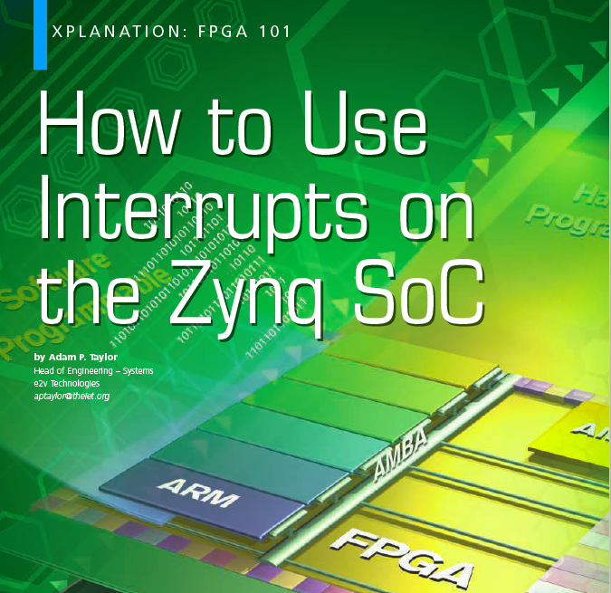
Recommended Reading Materials on Interrupts
How to Use Interrupts on the Zynq SoC, pp38-43, Xcell Journal 87, 2nd Quarter, 2014 (https://www.xilinx.com/publications/archives/xcell/Xcell87.pdf)
The ZYNQ Book
Chapter 10.4 Interrupts
Altera : Introduction to the ARM® Processor Using Altera Toolchain, Altera Corporation University Program, April 2014
ARM Generic Interrupt Controller – Architecture Specification
Chapter 1: Introduction
Chapter 2: GIC Partitioning
Chapter 3: Interrupt Handling and Prioritization
Chapter 4: Programmers’ Model

Slide 4
Exceptions from the ARM Architecture Reference Manual
Exceptions == Interrupts
ARM supports five types of exceptions, and a privileged processing mode for each type
Fast interrupt
Normal interrupt
Memory aborts
Attempted execution of an undefined instruction
Software interrupt (SWI) instructions
The exception process
When an exception occurs, the ARM processor halts execution after the current instruction and begins execution at one of a number of fixed addresses in memory, known as the exception vectors, one for each exception.
The exception vector stores the starting address of the handler, a subroutine, for an exception
The handler is loaded and ready to run
How to Use Interrupts on the Zynq SoC, Xcell Journal 87

Slide 5
Exceptions (Interrupts), Vector Table, Handlers, Interrupts
Exceptions:
ARM calls all special events “Exceptions” because they are exceptions to the normal instruction execution
Vector Table
ARM has a fixed address table (vector table) to store the starting addresses of subroutines, handlers, to serve exceptions
Handlers – exception (interrupt) service routines
The vector table needs to be initialized with correct handlers
Interrupts or Exceptions
External peripherals, devices and software call their special events “Interrupts” because they interrupt the normal program execution of ARM
How to Use Interrupts on the Zynq SoC, Xcell Journal 87

Slide 6
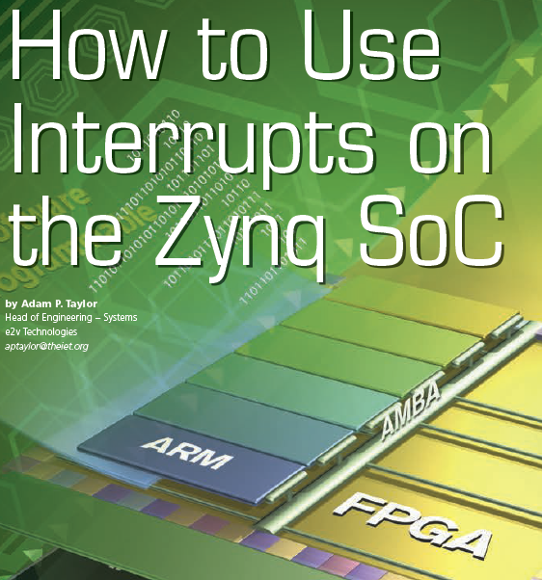
Processing Interrupts on Zynq SOC
1. An interrupt is shown as pending.
2. The processor stops executing the current thread.
3. The processor saves the state of the thread on stack to allow the thread to continue after it has handled the interrupt.
4. The processor executes the interrupt service routine, which defines how the interrupt is to be handled.
5. The processor resumes operation of the interrupted thread after restoring it from the stack
How to Use Interrupts on the Zynq SoC, Xcell Journal 87 at https://www.xilinx.com/publications/archives/xcell/Xcell87.pdf

Slide 7
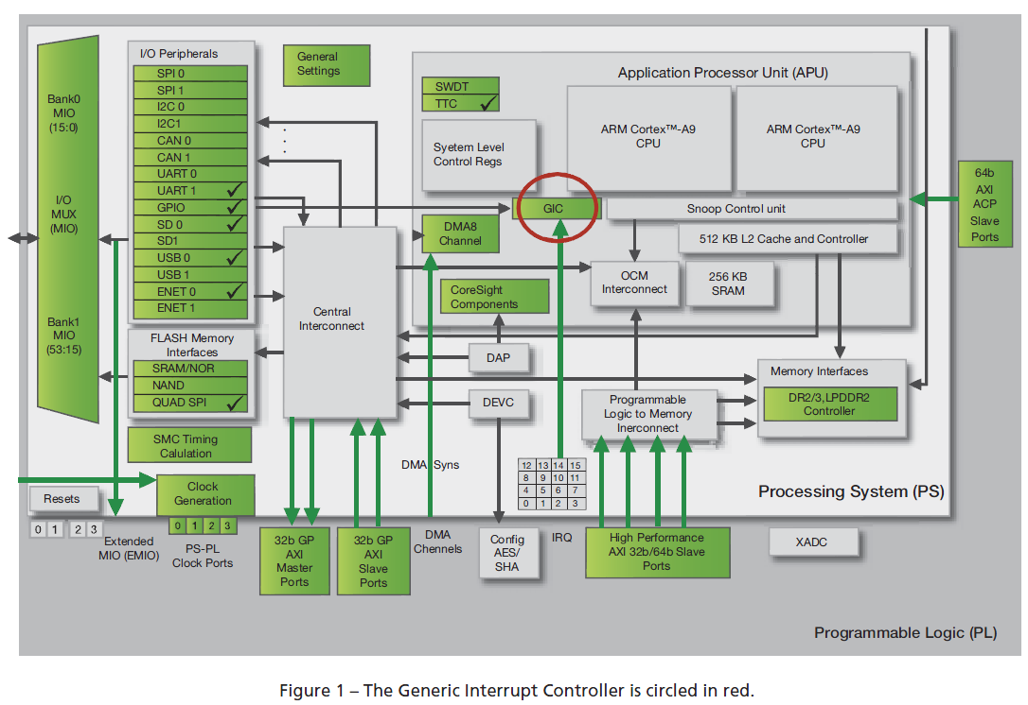
ARM® Generic Interrupt Controller (GIC)
The Zynq SoC uses a Generic Interrupt Controller (GIC) to handle interrupts from the total of 81 interrupt sources.
How to Use Interrupts on the Zynq SoC, Xcell Journal 87

Slide 8
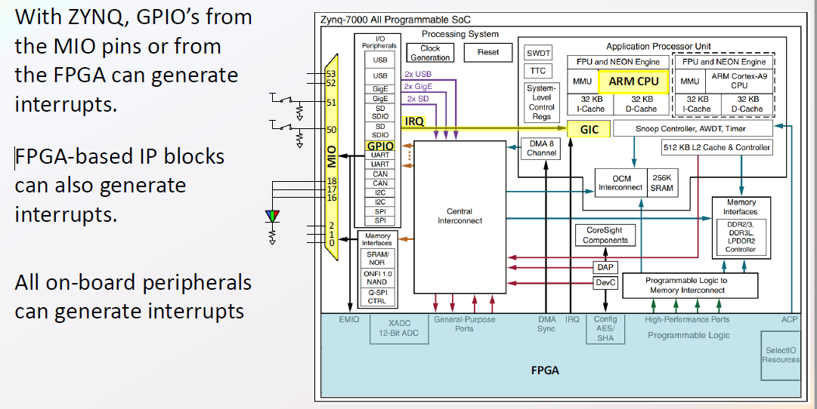
Flow of Interrupt Handling Process and Configuration
Level 3: Interrupt Sources
Level 2: Generic Interrupt Controller (GIC) and its vector table
Level 1: Cortex A6 CPU and its vector table
Level 3 ⇒ Level 2 ⇒ Level 1
From www.realdigitial.org – zynq/ARM Interrupt Controller

Slide 9
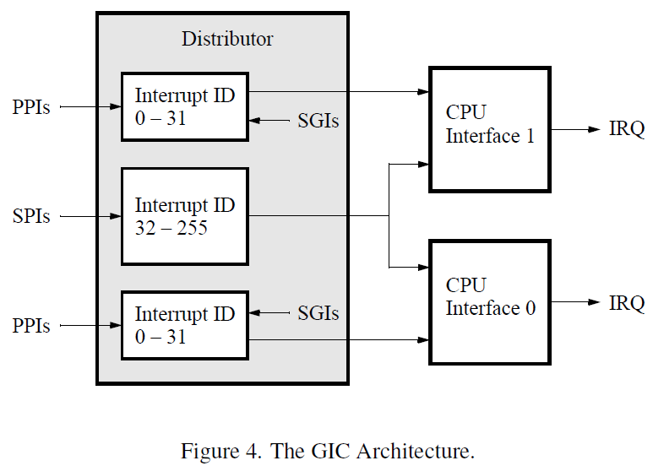
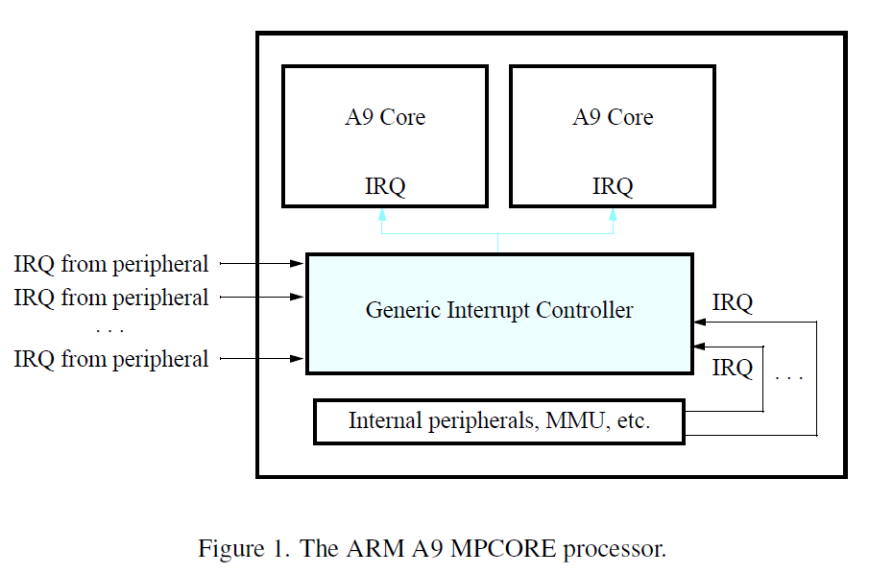
Three Levels of Interrupt Configurations with A9 Core, GIC, Interrupts
Level 1: A9 Core stores the exception vector table and knows which exception handler to use for each interrupt. Exception table needs to be initialized with exception handlers.
Level 2: GIC knows how interrupts are configured and when to send an interrupt to an A9 Core.
Level 3: Each interrupt needs to be configured and enabled.
Level 2
Level 1
Level 1
Level 3
Level 2
GIC Distributer can handle 255 sources of interrupts. A private peripheral interrupt (PPI) is assigned to one A9 core only while a shared peripheral interrupt (SPI) can be handled by both A9 cores.
Altera: Using the ARM Generic Interrupt Controller For Quartus II 14.0

Slide 10
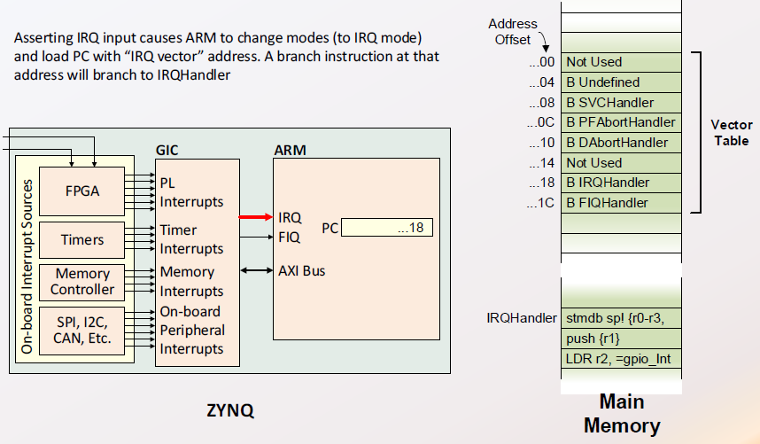
When an IRQ or FIQ Exception Occurs
Many sources can cause exception or interrupt
GIC controls IRQ (interrupt) or FIQ (fast interrupt)
The appropriate exception vector is called by GIC
ARM CPU calls GIC handler when IRQ occurs
Level 3 ⇒ Level 2 ⇒ Level 1
From www.realdigitial.org – zynq/ARM Interrupt Controller

Slide 11
Interrupt Sources Controlled by GIC: 16+44+16+5=81
16 Software-generated interrupts
16 such interrupts for each processor. They can interrupt one or both of the Zynq SoC’s ARM® Cortex™-A9 processor cores.
60 Shared peripheral interrupts
60 interrupts can come from the I/O peripherals, or to and from the programmable logic (PL) side of the device. They are shared between the Zynq SoC’s two CPUs.
44 interrupts can be routed to either CPU from the I/O peripherals.
16 interrupts can be routed from the PL.
5 Private peripheral interrupts
5 interrupts in this category are private to each CPU—for example CPU timer, CPU watchdog timer and dedicated PL-to-CPU interrupt.
How to Use Interrupts on the Zynq SoC, Xcell Journal 87

Slide 12
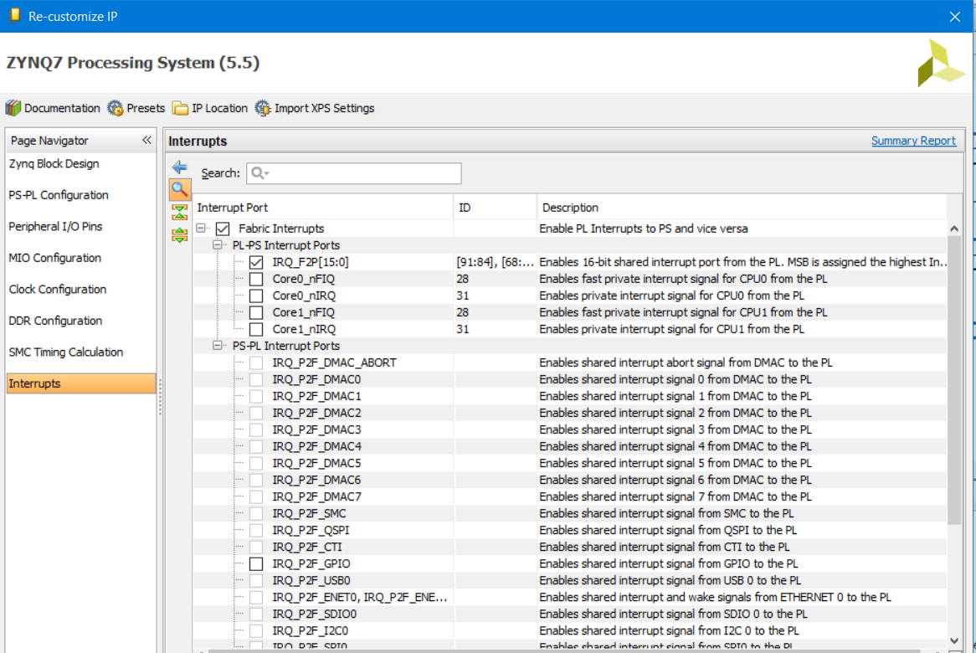
Interrupt Sources Shown in Interrupts Menu on Zynq7 PS
How to Use Interrupts on the Zynq SoC, Xcell Journal 87

Slide 13
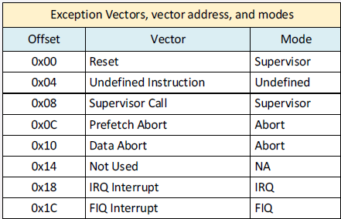
Level 1: Exception (Interrupt) Vector Table of Cortex A9 Core
Cortex A9 Core CPU has eight exception vectors as follows.
The vectors are the starting address of exception handlers
There is one IRQ vector and one FIQ (fast interrupt) vector
When an IRQ occurs, its handler is called.
In xil_exception.h, IRQ is defined as follow.
#define XIL_EXCEPTION_ID_IRQ_INT 5U
Xil_ExceptionRegisterHandler(5, My_IRQ_Handler, NULL);
GIC handler is called as IRQ handler
#define XIL_EXCEPTION_ID_INT XIL_EXCEPTION_ID_IRQ_INT
Xil_ExceptionRegisterHandler(XIL_EXCEPTION_ID_INT,
(Xil_ExceptionHandler) XScuGic_InterruptHandler,
XScuGicInstancePtr);
From www.realdigitial.org – zynq/ARM Interrupt Controller

Slide 14
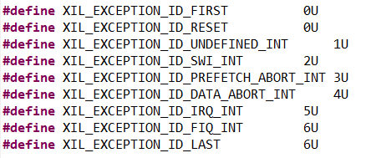
Level 1: Interrupt Configuration for A9 Core in xil_exception.h
Cortex A9 Core interrupt table stores 8 interrupt handlers
extern void Xil_ExceptionRegisterHandler(u32 id, Xil_ExceptionHandler handler, void *data);
Install handler for id
extern void Xil_ExceptionRemoveHandler(u32 id);
extern void Xil_ExceptionInit(void);
extern void Xil_DataAbortHandler(void *CallBackRef);
extern void Xil_PrefetchAbortHandler(void *CallBackRef);
Xil_exception.h defines 9 interrupt IDs
Altera: Using the ARM Generic Interrupt Controller For Quartus II 14.0

Slide 15
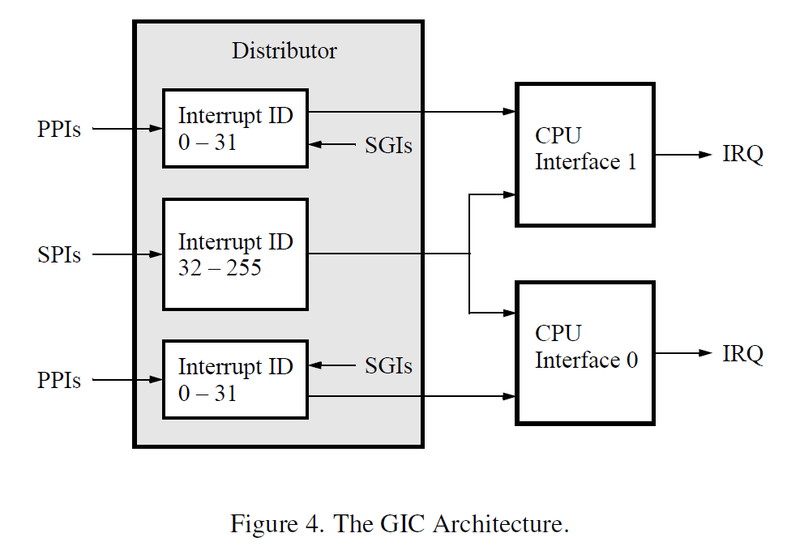
Level 2: Generic Interrupt Controller
GIC sits between interrupt sources and ARM CPU
GIC Distributor receives IRQ signals from I/O peripherals
GIC CPU Interface sends IRQ request to ARM A9 CPU and stores source of interrupt
The CPU needs to read Interrupt Acknowledge Register to find the source ID
A private peripheral interrupt (PPI) or a software generated interrupt (SGI) can only be served by a single CPU
A shared peripheral interrupt (SPI) can be served by more than one CPU
GIC’s Interrupt Handler can also be used directly to serve interrupts
void XScuGic_InterruptHandler(XScuGic *InstancePtr);
Altera: Using the ARM Generic Interrupt Controller For Quartus II 14.0

Slide 16
Level 2: Interrupt Configuration for GIC in xscugic.h
Configure and initialize a GIC Device
XScuGic INTCInst; //GIC device class instance
IntcConfig = XScuGic_LookupConfig(XPAR_PS7_SCUGIC_0_DEVICE_ID);
status = XScuGic_CfgInitialize(&INTCInst, IntcConfig, IntcConfig->CpuBaseAddress);
Connect Interrupt handler to GIC device
status = XScuGic_Connect(&INTCInst, XPAR_FABRIC_AXI_GPIO_0_IP2INTC_IRPT_INTR, (Xil_ExceptionHandler)BTN_Intr_Handler, (void *)GpioInstancePtr);
Enable interrupts
XScuGic_Enable(&INTCInst, INTC_GPIO_INTERRUPT_ID);
XScuGic_Enable(&INTCInst, INTC_TMR_INTERRUPT_ID);
void XScuGic_InterruptHandler(XScuGic *InstancePtr) {} is a function from GIC driver library

Slide 17
Level 3: Interrupt Configuration for XGPIO in xgpio.h
Interrupt occurs on level changes on both edges – Global
void XGpio_InterruptGlobalEnable(XGpio * InstancePtr);
void XGpio_InterruptGlobalDisable(XGpio * InstancePtr)
These functions will need to be called first before individual calls
Enable and disable both channels
void XGpio_InterruptEnable(XGpio *InstancePtr, u32 Mask); //local
Mask=1 to enable interrupt, e.g., #define XGPIO_IR_CH1_MASK 0x1
void XGpio_InterruptDisable(XGpio * InstancePtr, u32 Mask)
These functions will not work if Global functions are not called once.
void XGpio_InterruptClear(XGpio *InstancePtr, u32 Mask);
u32 XGpio_InterruptGetEnabled(XGpio *InstancePtr);
u32 XGpio_InterruptGetStatus(XGpio *InstancePtr);
Altera: Using the ARM Generic Interrupt Controller For Quartus II 14.0

Slide 18
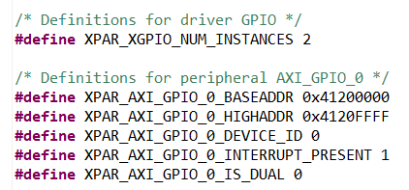
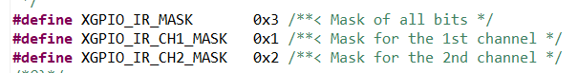
Level 3 Example: Configure Push Button Interrupt
#define BTNS_DEVICE_ID XPAR_AXI_GPIO_0_DEVICE_ID
#define BTN_INT XGPIO_IR_CH1_MASK
XGpio BTNInst;
// Initialize Push Buttons
status = XGpio_Initialize(&BTNInst, BTNS_DEVICE_ID);
if(status != XST_SUCCESS) return XST_FAILURE;
// Set all buttons direction to inputs
XGpio_SetDataDirection(&BTNInst, 1, 0xFF);
//Enable global interrupt first and once only
XGpio_InterruptGlobalEnable(&BTNInst);
//enable channel 1 interrupt
XGpio_InterruptEnable(&BTNInst, BTN_INT);

Slide 19
Level 3 Example: Interrupt Configuration for AXI Timer in xtmrctr.h
int XTmrCtr_Initialize(XTmrCtr * InstancePtr, u16 DeviceId);
XTmrCtr_Config *XTmrCtr_LookupConfig(u16 DeviceId);
void XTmrCtr_SetResetValue(XTmrCtr * InstancePtr, u8 TmrCtrNumber, u32 ResetValue);
void XTmrCtr_SetHandler(XTmrCtr * InstancePtr, XTmrCtr_Handler FuncPtr, void *CallBackRef);
void XTmrCtr_SetOptions(XTmrCtr * InstancePtr, u8 TmrCtrNumber, u32 Options);
int XTmrCtr_IsExpired(XTmrCtr * InstancePtr, u8 TmrCtrNumber);
void XTmrCtr_Start(XTmrCtr * InstancePtr, u8 TmrCtrNumber);
void XTmrCtr_Stop(XTmrCtr * InstancePtr, u8 TmrCtrNumber);
Altera: Using the ARM Generic Interrupt Controller For Quartus II 14.0

Slide 20
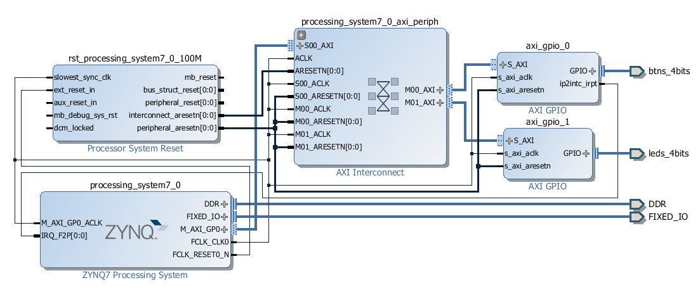
Example 2B: Zynq_Book_Tutorials 2, The_Zynq_Book_Tutorials, v1.2
interrupt_counter_tut_2B.c, XGPIO Interrupt by push button
Four LEDs as a four-bit counter, increased by interrupts from four push buttons
Button 0 will increment the counter by 1 //LEDs=LEDs+Buttons
Button 1 will increment the counter by 2, Button 2 by 4 and Button 3 by 8 each time they are pressed
The_Zynq_Book_Tutorials, v1.2

Slide 21
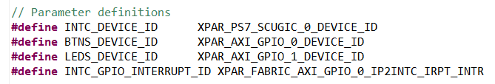
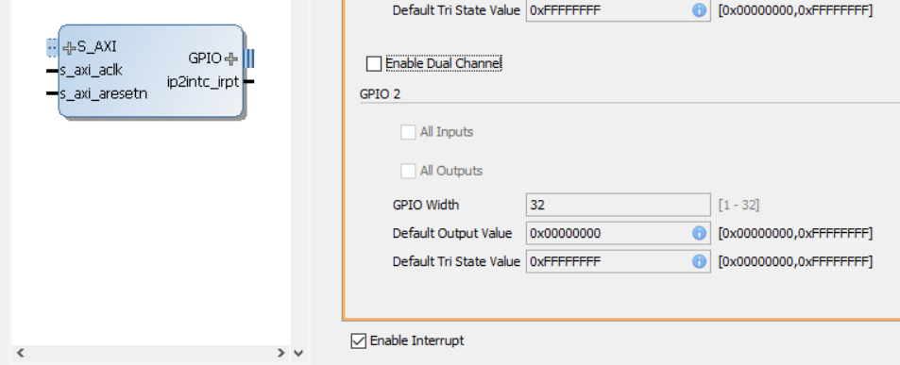
Example 2B, Devices Exported by xparameters.h and Three Devices
General Interrupt Controller Device
Interrupt-Enabled GPIO 0 device for buttons
GPIO 1 device for LEDs
Three Device IDs and one Interrupt GPIO ID
GPIO interrupt enable:
The_Zynq_Book_Tutorials, v1.2

Slide 22
Example 2B, Devices Exported by xparameters.h and Three Types
General Interrupt Controller Device
Interrupt-Enabled GPIO 0 for buttons
GPIO 1 for LEDs
Example 2D has one more device AXI_Timer and its interrupt
Three Types of Interrupt Configurations
GIC
A9 CORE
GPIO
AXI_TIMER
The_Zynq_Book_Tutorials, v1.2

Slide 23
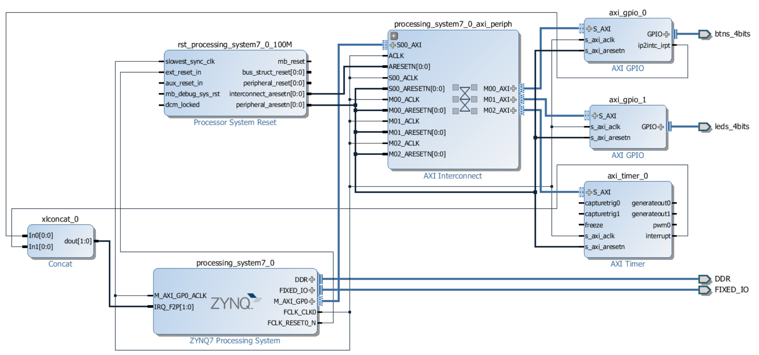
Example 2D: Zynq_Book_Tutorials 2, The_Zynq_Book_Tutorials, v1.2
XGPIO and AXI Timer Interrupts
The_Zynq_Book_Tutorials, v1.2

Slide 24
Example 2D: Zynq_Book_Tutorials 2, The_Zynq_Book_Tutorials, v1.2
interrupt_counter_tut_2D.c, XGPIO and AXI Timer Interrupts
Four LEDs as a four-bit counter, incremented by AXI Timer Interrupt
Four push buttons – interrupt driven to display button state on LEDs
LEDs work with both counter and button interrupts, independent of each other
AXI Timer in Verilog on PL, a count-up timer
The_Zynq_Book_Tutorials, v1.2

Slide 25
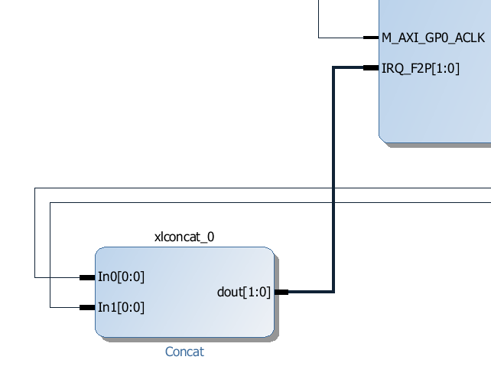
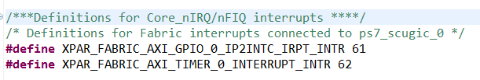
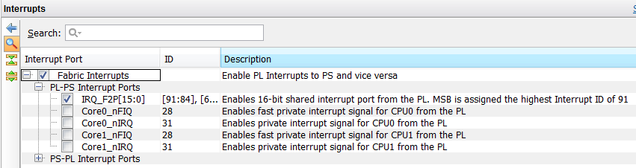
Zynq_Book_Tutorials 2: Interrupt Configuration from PL
IRQ_F2P[1:0] – two interrupt sources: buttons and Timer
In0[0:0] – axi_gpio_0 - buttons
In1[0:0] – axi_timer_0 - timer
Exported to xparameters.h file

Slide 26
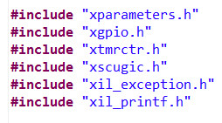
The board support package (BSP) and Interrupts on the Zynq SoC
Xparameters.h – Zybo board
This file contains the processor’s address space and the device IDs.
Xscugic.h – Generic Interrupt Controller
The generic interrupt controller driver component.
This file holds the drivers for the configuration and use of the GIC.
SCU stands for Snoop Control Unit.
Xil_exception.h – Cortex A9
This header file contains ARM Cortex A9 specific exception related APIs.
xtmrctr.h – AXI Timer
This component supports the Xilinx AXI timer/counter.
xgpio.h
Xilinx General Purpose I/O (XGpio) device driver.
How to Use Interrupts on the Zynq SoC, Xcell Journal 87

Slide 27
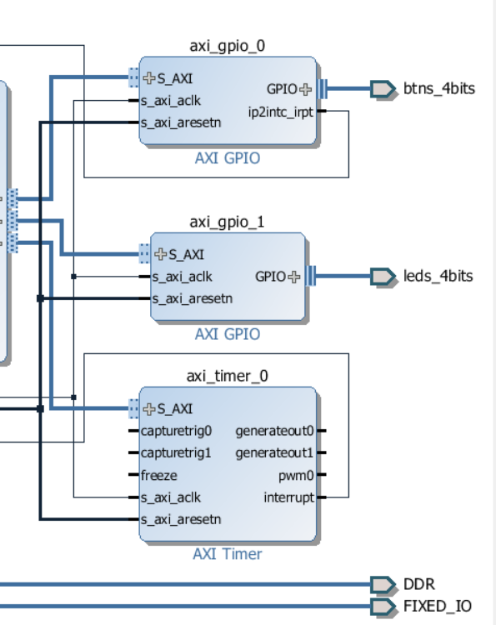
Device IDs, Interrupt IDs and Device Instances
Device IDs in xparameter.h – Hardware definitions
#define INTC_DEVICE_ID XPAR_PS7_SCUGIC_0_DEVICE_ID
#define TMR_DEVICE_ID XPAR_TMRCTR_0_DEVICE_ID
#define BTNS_DEVICE_ID XPAR_AXI_GPIO_0_DEVICE_ID
#define LEDS_DEVICE_ID XPAR_AXI_GPIO_1_DEVICE_ID
#define INTC_GPIO_INTERRUPT_ID XPAR_FABRIC_AXI_GPIO_0_IP2INTC_IRPT_INTR
#define INTC_TMR_INTERRUPT_ID XPAR_FABRIC_AXI_TIMER_0_INTERRUPT_INTR
Device Declaration for LEDs, Push buttons
XGpio LEDInst, BTNInst;
GIC Device
XScuGic INTCInst;
AXI Timer Device
XTmrCtr TMRInst;

Slide 28
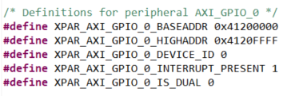
Data Structures of GPIO Instance and Device in xparameters.h
//from xgpio.h
typedef struct {
u16 DeviceId; /* Unique ID of device */
u32 BaseAddress; /* Device base address */
int InterruptPresent; /* Are interrupts supported in h/w */
int IsDual; /* Are 2 channels supported in h/w */
} XGpio_Config;
/* The XGpio driver instance data. The user is required to allocate a
* variable of this type for every GPIO device in the system. A pointer
* to a variable of this type is then passed to the driver API functions.*/
typedef struct {
u32 BaseAddress; /* Device base address */
u32 IsReady; /* Device is initialized and ready */
int InterruptPresent; /* Are interrupts supported in h/w */
int IsDual; /* Are 2 channels supported in h/w */
} XGpio;

Slide 29
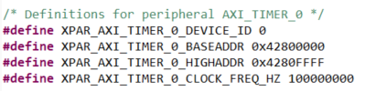
Data Structures of AXI Timer Instance and Device in xparameters.h
//from xtmrctr.h
typedef struct {
u16 DeviceId; /**< Unique ID of device */
u32 BaseAddress; /**< Register base address */
} XTmrCtr_Config;
typedef struct {
XTmrCtrStats Stats; /**< Component Statistics */
u32 BaseAddress; /**< Base address of registers */
u32 IsReady; /**< Device is initialized and ready */
u32 IsStartedTmrCtr0; /**< Is Timer Counter 0 started */
u32 IsStartedTmrCtr1; /**< Is Timer Counter 1 started */
XTmrCtr_Handler Handler; /**< Callback function */
void *CallBackRef; /**< Callback reference for handler */
} XTmrCtr;

Slide 30
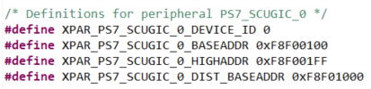
Data Structures of GIC Instance and Device in xparameters.h
//from xscugic.h
typedef struct
{
u16 DeviceId; /**< Unique ID of device */
u32 CpuBaseAddress; /**< CPU Interface Register base address */
u32 DistBaseAddress; /**< Distributor Register base address */
/*Vector table of interrupt handlers */
XScuGic_VectorTableEntry HandlerTable[XSCUGIC_MAX_NUM_INTR_INPUTS];
} XScuGic_Config;
typedef struct
{
XScuGic_Config *Config; /**< Configuration table entry */
u32 IsReady; /**< Device is initialized and ready */
u32 UnhandledInterrupts; /**< Intc Statistics */
} XScuGic;

Slide 31
Level 1, Level 2 and Level 3 Interrupt Configurations
Level 3: Interrupt Sources
Level 2: Generic Interrupt Controller (GIC) and its vector table
Level 1: Cortex A6 CPU and its vector table
Level 3 ⇒ Level 2 ⇒ Level 1
From www.realdigitial.org – zynq/ARM Interrupt Controller

Slide 32
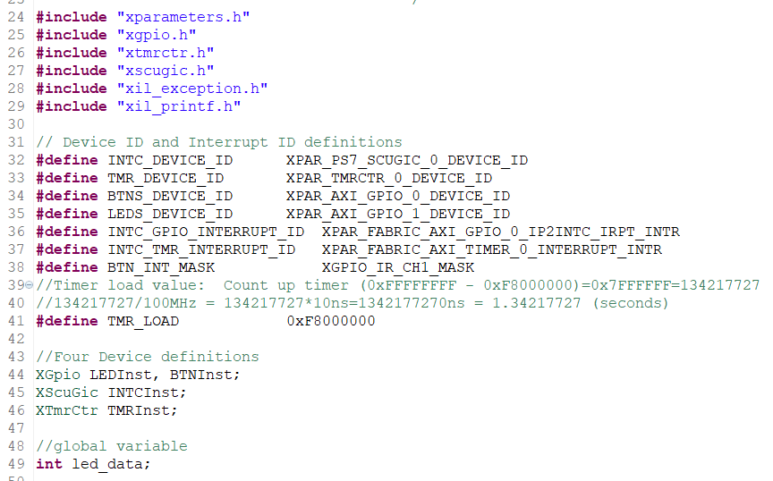
interrupt_counter_tut_2D_new.c
Revised the original code with a number of calls and remove all warnings.
interrupt_counter_tut_2D_new.c; Count up to (2³²-0xF8000000)

Slide 33
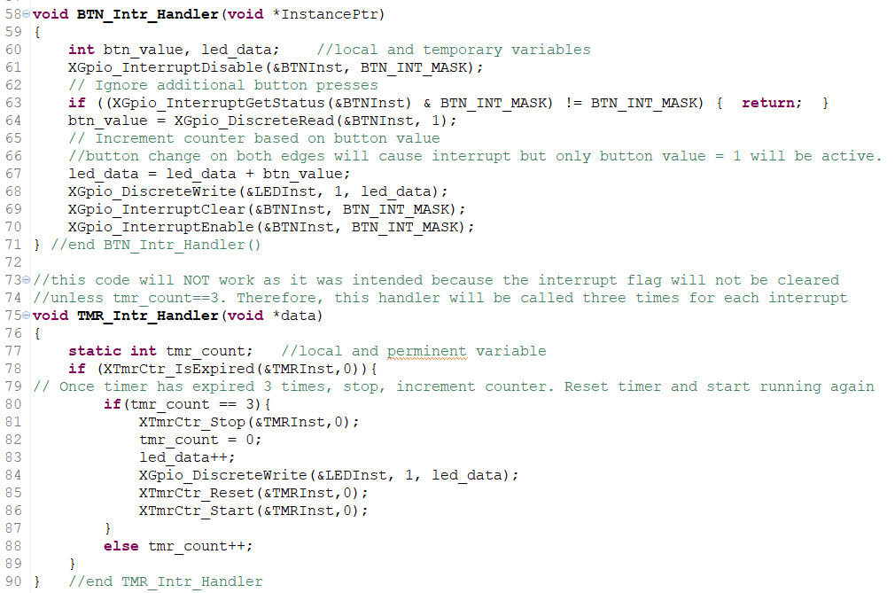
interrupt_counter_tut_2D_new.c

Slide 34
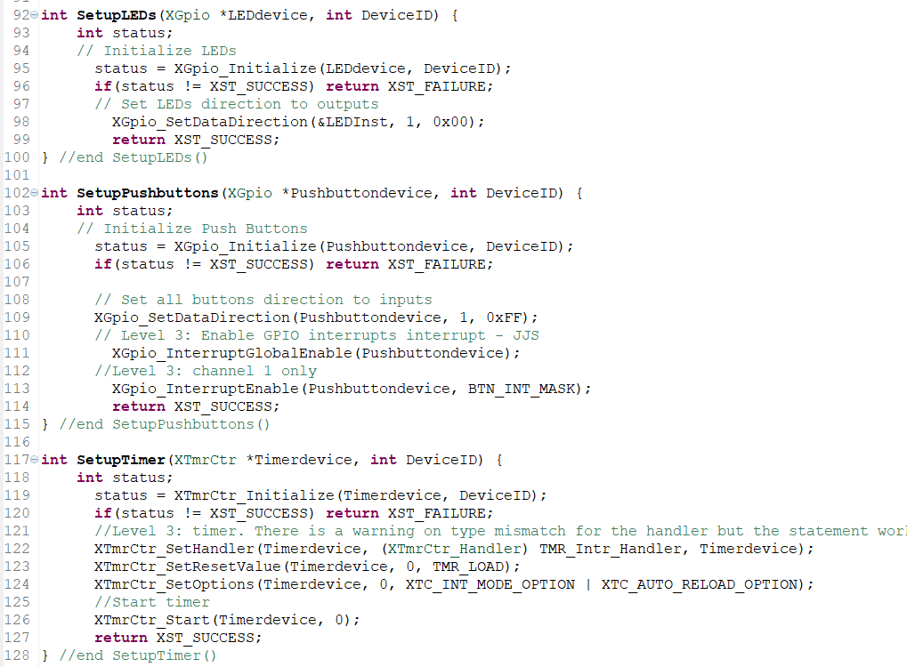

Slide 35
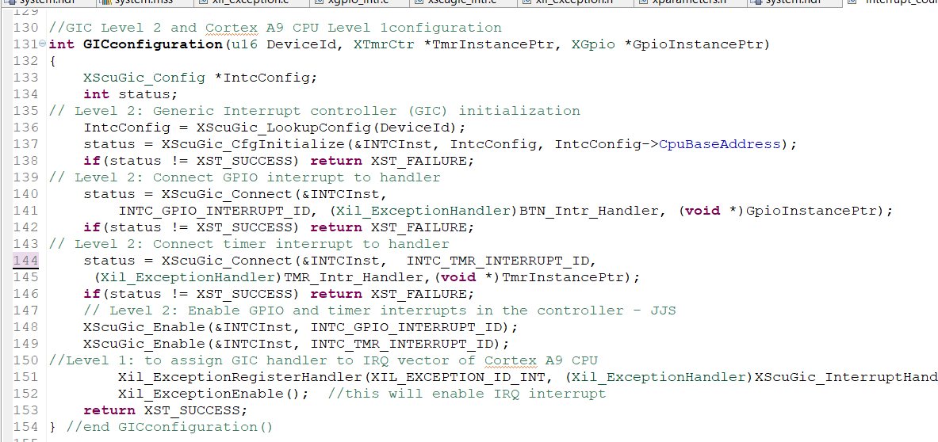

Slide 36
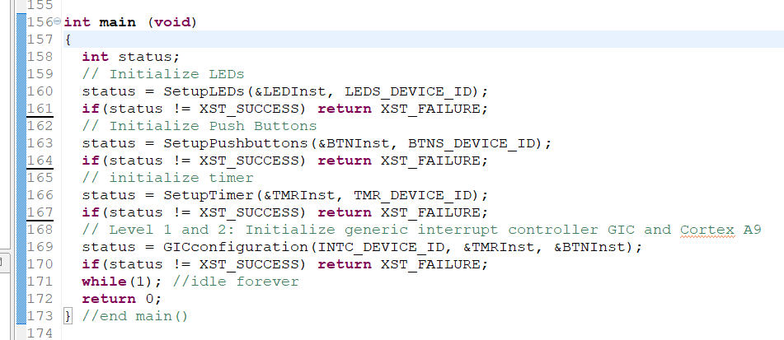

Slide 37
Level 1: Initialize IRQ of Cortex A9 to Accept GIC Handler
Xil_ExceptionInit(); - empty routine for Cortex-A9
void Xil_ExceptionRegisterHandler(u32 exception_id, Xil_ExceptionHandler Handler, void *Data)
exception_id contains the ID of the exception source
Handler to the Handler for that exception.
Data is a reference to Data that will be passed to the Handler
#define Xil_ExceptionEnable() \ Xil_ExceptionEnableMask(XIL_EXCEPTION_IRQ)
int InterruptSystemSetup(XScuGic *XScuGicInstancePtr)
{
//Level 1 to assign GIC handler to IRQ vector of Cortex A9 CPU
Xil_ExceptionRegisterHandler(XIL_EXCEPTION_ID_INT,
(Xil_ExceptionHandler)XScuGic_InterruptHandler,
XScuGicInstancePtr);
Xil_ExceptionEnable();
return XST_SUCCESS;
}

Slide 38
Level 2: Initialize The Generic Interrupt Controller Instance INTCInst
IntcConfig = XScuGic_LookupConfig(DeviceId);
XScuGic_CfgInitialize(&INTCInst, IntcConfig, IntcConfig >CpuBaseAddress);
XScuGic_Connect(&INTCInst, INTC_GPIO_INTERRUPT_ID, (Xil_ExceptionHandler)BTN_Intr_Handler, (void *)GpioInstancePtr);
Makes the connection between the Int_Id of the interrupt source and the associated handler that is to run when the interrupt is recognized.
XScuGic_Connect(&INTCInst, NTC_TMR_INTERRUPT_ID, (Xil_ExceptionHandler)TMR_Intr_Handler, (void *)TmrInstancePtr);
XScuGic_Enable(&INTCInst, INTC_GPIO_INTERRUPT_ID);
Enables the interrupt source provided as the argument Int_Id.
XScuGic_Enable(&INTCInst, INTC_TMR_INTERRUPT_ID);

Slide 39
LeveL 3: Initialize an Interrupt from XGPIO: XGpio_InterruptEnable()
XGpio_InterruptEnable(&BTNInst, BTN_INT);
InstancePtr is the GPIO instance to operate on.
Mask is the mask to enable. Bit positions of 1 are enabled.
BTN_INT=0x1 //first channel
void XGpio_InterruptEnable(XGpio * InstancePtr, u32 Mask)
{
u32 Register;
Xil_AssertVoid(InstancePtr != NULL);
Xil_AssertVoid(InstancePtr->IsReady == XIL_COMPONENT_IS_READY);
Xil_AssertVoid(InstancePtr->InterruptPresent == TRUE);
/*
* Read the interrupt enable register and only enable the specified
* interrupts without disabling or enabling any others.
*/
Register = XGpio_ReadReg(InstancePtr->BaseAddress, XGPIO_IER_OFFSET);
XGpio_WriteReg(InstancePtr->BaseAddress, XGPIO_IER_OFFSET,
Register | Mask);
}

Slide 40
Initialize an Interrupt from a Peripheral Device: XGpio_InterruptGlobalEnable()
XGpio_InterruptGlobalEnable (&BTNInst)
Enable the interrupt output signal. Interrupts enabled through XGpio_InterruptEnable() will not be passed through until the global enable bit is set by this function.
void XGpio_InterruptGlobalEnable(XGpio * InstancePtr)
{
Xil_AssertVoid(InstancePtr != NULL);
Xil_AssertVoid(InstancePtr->IsReady == XIL_COMPONENT_IS_READY);
Xil_AssertVoid(InstancePtr->InterruptPresent == TRUE);
XGpio_WriteReg(InstancePtr->BaseAddress, XGPIO_GIE_OFFSET,
XGPIO_GIE_GINTR_ENABLE_MASK);
}

Slide 41
interrupt_counter_tut_2D_new.c: Setup Button Interrupts
int SetupPushbuttons(XGpio *Pushbuttondevice, int DeviceID) {
int status;
// Initialize Push Buttons
status = XGpio_Initialize(Pushbuttondevice, DeviceID);
if(status != XST_SUCCESS) return XST_FAILURE;
// Set all buttons direction to inputs
XGpio_SetDataDirection(Pushbuttondevice, 1, 0xFF);
// Level 3: Enable GPIO interrupts interrupt - JJS
XGpio_InterruptGlobalEnable(Pushbuttondevice);
//Level 3: channel 1 only
XGpio_InterruptEnable(Pushbuttondevice, BTN_INT_MASK);
return XST_SUCCESS;
} //end SetupPushbuttons()
AXI GPIO v2.0, PG144 November 18, 2015

Slide 42
interrupt_counter_2D_new.c: Setup AXI Timer
//Interrupt interval is 1.34 seconds
#define TMR_LOAD 0xF8000000
XTmrCtr TMRInst;
int SetupTimer(XTmrCtr *Timerdevice, int DeviceID) {
int status;
int SetupTimer(XTmrCtr *Timerdevice, int DeviceID) {
int status;
status = XTmrCtr_Initialize(Timerdevice, DeviceID);
if(status != XST_SUCCESS) return XST_FAILURE;
//Level 3: timer. There is a warning on type mismatch for the handler but the statement works.
XTmrCtr_SetHandler(Timerdevice, (XTmrCtr_Handler) TMR_Intr_Handler, Timerdevice);
XTmrCtr_SetResetValue(Timerdevice, 0, TMR_LOAD);
XTmrCtr_SetOptions(Timerdevice, 0, XTC_INT_MODE_OPTION | XTC_AUTO_RELOAD_OPTION);
//Start timer
XTmrCtr_Start(Timerdevice, 0);
return XST_SUCCESS;
} //end SetupTimer()
AXI GPIO v2.0, PG144 November 18, 2015

Slide 43
interrupt_counter_2D.c: AXI Timer Interrupt Handler
static int tmr_count;
//this code will NOT work as it was intended
//because the interrupt flag will not be cleared unless tmr_count==3
//therefore, this handler will be called three times for each interrupt
void TMR_Intr_Handler(void *data)
{
if (XTmrCtr_IsExpired(&TMRInst,0)){
// Once timer has expired 3 times, stop, increment counter
// reset timer and start running again
if(tmr_count == 3){
XTmrCtr_Stop(&TMRInst,0);
tmr_count = 0;
led_data++;
XGpio_DiscreteWrite(&LEDInst, 1, led_data);
XTmrCtr_Reset(&TMRInst,0);
XTmrCtr_Start(&TMRInst,0); //to clear interrupt flag
}
else tmr_count++;} }
XTmrCtr_Start(&TMRInst,0);
//to clear interrupt flag
AXI GPIO v2.0, PG144 November 18, 2015

Slide 44
Execute to Clear Interrupt Flag: void XTmrCtr_Start(); in xtmrctr.c
/*Starts the specified timer counter of the device such that it starts running. The timer counter is reset
before it is started and the reset value is loaded into the timer counter.*/
void XTmrCtr_Start(XTmrCtr * InstancePtr, u8 TmrCtrNumber)
{
u32 ControlStatusReg;
Xil_AssertVoid(InstancePtr != NULL);
Xil_AssertVoid(TmrCtrNumber < XTC_DEVICE_TIMER_COUNT);
Xil_AssertVoid(InstancePtr->IsReady == XIL_COMPONENT_IS_READY);
/* Read the current register contents such that only the necessary bits of the register are modified in the following operations */
ControlStatusReg = XTmrCtr_ReadReg(InstancePtr->BaseAddress, TmrCtrNumber, XTC_TCSR_OFFSET);
/* Reset the timer counter such that it reloads from the compare register and the interrupt is cleared simultaneously, the interrupt can only be cleared after reset so that the interrupt condition is cleared*/
XTmrCtr_WriteReg(InstancePtr->BaseAddress, TmrCtrNumber, TC_TCSR_OFFSET, XTC_CSR_LOAD_MASK);
/* Indicate that the timer is started before enabling it */
if (TmrCtrNumber == 0) { InstancePtr->IsStartedTmrCtr0 = XIL_COMPONENT_IS_STARTED;
} else { InstancePtr->IsStartedTmrCtr1 = XIL_COMPONENT_IS_STARTED; }
/* Remove the reset condition such that the timer counter starts running with the value loaded from the compare register */
XTmrCtr_WriteReg(InstancePtr->BaseAddress, TmrCtrNumber, XTC_TCSR_OFFSET,
ControlStatusReg | XTC_CSR_ENABLE_TMR_MASK);
}
AXI GPIO v2.0, PG144 November 18, 2015

Slide 45
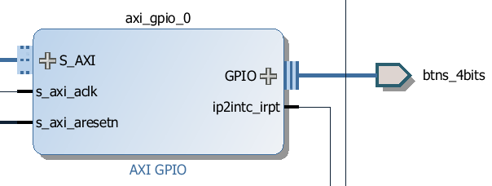
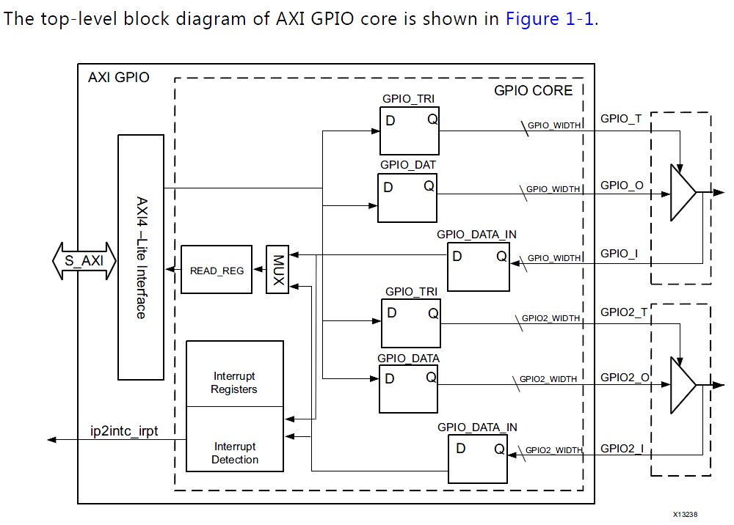
AXI GPIO Core
Reference: AXI GPIO v2.0, LogiCORE IP Product Guide, Vivado Design Suite, PG144 November 18, 2015
Two Channels
Data Registers to store data written to port, not used for input port
Each I/O pin of the AXI GPIO is individually programmable as an input or output.
0 = I/O pin configured as output.
1 = I/O pin configured as input.
AXI GPIO v2.0, PG144 November 18, 2015

Slide 46
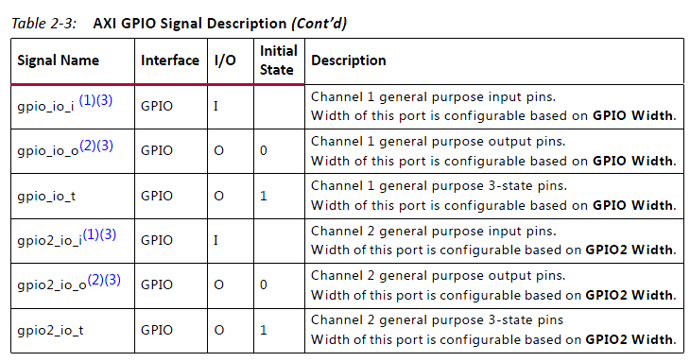
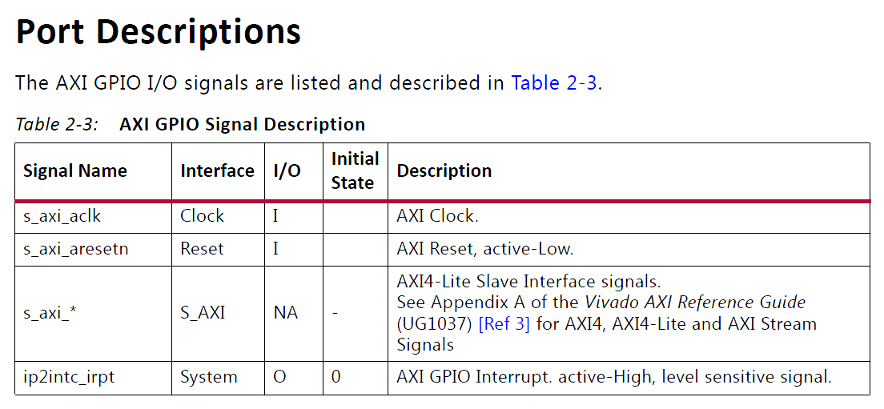
AXI GPIO Ports and Interrupt: Port Pin Change Interrupt
Ip2intc_irpt AXI GPIO Interrupt output pin
Active-High, Level Sensitive Signal
If the interrupt is enabled, a transition on any input causes a level interrupt
AXI GPIO v2.0, PG144 November 18, 2015

Slide 47
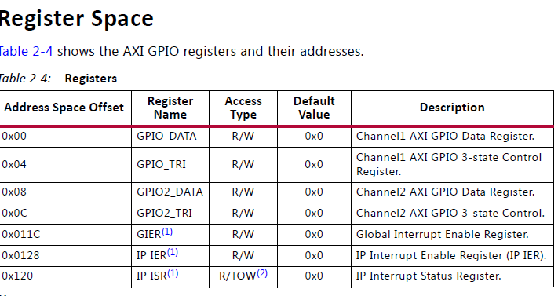
AXI GPIO Register Space
GIER – Global Interrupt Enable Register
IP IER – IP Interrupt Enable Register
IP ISR – IP Interrupt Status Register
AXI GPIO v2.0, PG144 November 18, 2015

Slide 48
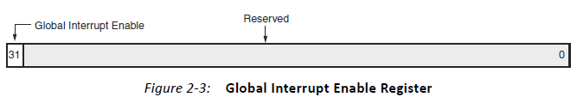
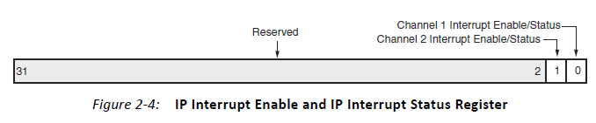
AXI GPIO Interrupt Registers
Global Interrupt Enable Register (GIER) – one bit register
Bit 31 is used to enable interrupt: 1 to enable and 0 to disable interrupt
void XGpio_InterruptGlobalEnable(XGpio *InstancePtr);
void XGpio_InterruptGlobalDisable(XGpio *InstancePtr);
IP Interrupt Enable Register (IP IER) – Implements the independent interrupt enable bit for each channel.
Bit 0 for Channel 1
Bit 1 for Channel 2
AXI GPIO v2.0, PG144 November 18, 2015

Slide 49
AXI GPIO Interrupt Registers
void XGpio_InterruptEnable(XGpio *InstancePtr, u32 Mask);
void XGpio_InterruptDisable(XGpio *InstancePtr, u32 Mask);
IP Interrupt Status Register (IP ISR) – Implements the independent interrupt status bit for each channel. The IP ISR provides Read and Toggle-On-Write access.
Bit 0 for Channel 1 – 1 to flag interrupt and 0 to indicate no interrupt
Bit 1 for Channel 2 - 1 to flag interrupt and 0 to indicate no interrupt
void XGpio_InterruptClear(XGpio *InstancePtr, u32 Mask);
u32 XGpio_InterruptGetEnabled(XGpio *InstancePtr);
u32 XGpio_InterruptGetStatus(XGpio *InstancePtr);
AXI GPIO v2.0, PG144 November 18, 2015

Slide 50
AXI Timers – Implemented on the FPGA fabric
Reference: AXI Timer v2.0, LogiCORE IP Product Guide, Vivado Design Suite, PG079 November 18, 2015
The LogiCORE™ IP AXI Timer/Counter is a 32/64-bit timer module that interfaces to the AXI4-Lite interface.
Two programmable interval timers with
interrupt, event generation, and event capture capabilities
Configurable counter width
One Pulse Width Modulation (PWM) output
Cascaded operation of timers in generate and capture modes
The clock rate of the timer modules is s_axi_aclk (no prescaling of the clock is performed)
Interrupt on Timer overflow, either counting up or down.
Timer counts up by default
AXI Timer v2.0, PG079, November 18, 2015

Slide 51
AXI Timers on the FPGA Fabric
AXI4-Lite Interface:
The AXI4-Lite Interface module implements an AXI4-Lite slave interface for accessing memory mapped Timer registers. For details about the AXI4-Lite slave interface.
Timer Registers:
The Register block implements a set of 32-bit registers for each timer/counter. This set of register contains load register, timer/counter register and control/status register.
32-bit Counters:
The Timer/Counter module has two 32-bit counters, each of which can be configured for up/down counts and can be loaded with a value from the load register.
Interrupt Control:
The Interrupt control module generates a single interrupt depending on the mode of operation.
AXI Timer v2.0, PG079, November 18, 2015

Slide 52
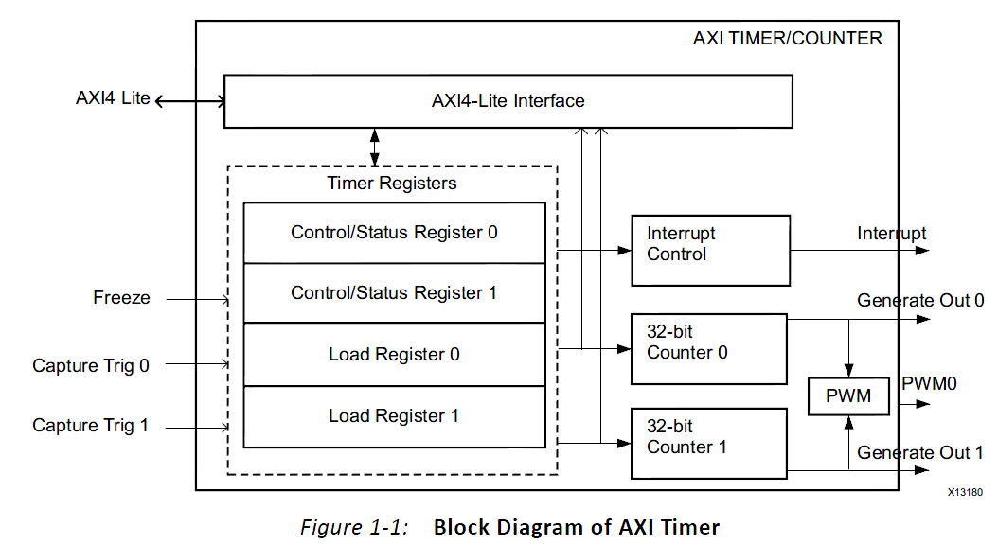
AXI Timers on the FPGA Fabric
Pulse Width Modulation (PWM):
The PWM block generates a pulse signal, PWM0, with a specified frequency and duty factor. It uses Timer 0 for PWM0 period, and Timer 1 for PWM0 output width.
The clock rate of the timer modules is s_axi_aclk (no prescaling of the clock is performed)
AXI Timer v2.0, PG079, November 18, 2015

Slide 53
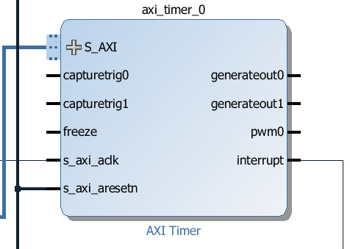

Slide 54
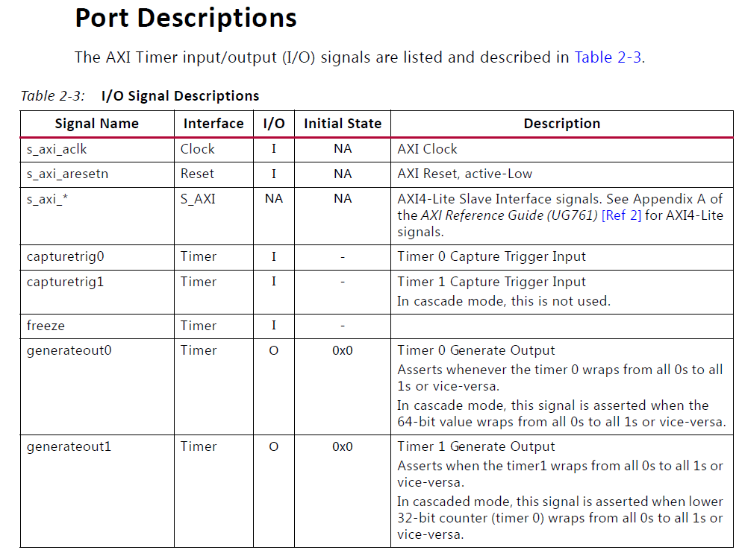
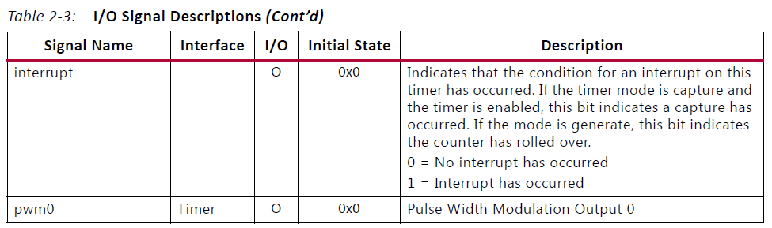
AXI Clock
AXI active low reset
Input captures
Overflow flags
Interrupt
PWM output
AXI Timer v2.0, PG079, November 18, 2015

Slide 55
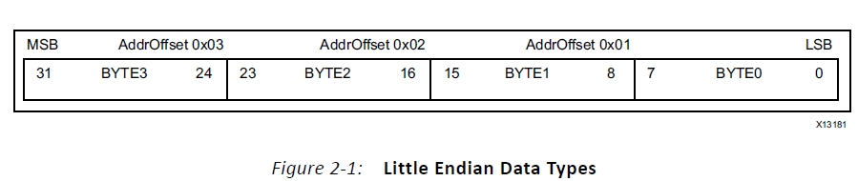
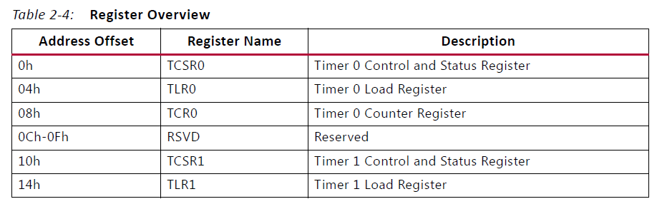
AXI Timers: Registers
TCR0 and TCR1
Timer/Counter accessible in Byte (8 bits) , Half Word (16 bits), Word (32 bits)
TCSR0 and TCSR1
TLR0 and TLR1
AXI Timer v2.0, PG079, November 18, 2015

Slide 56
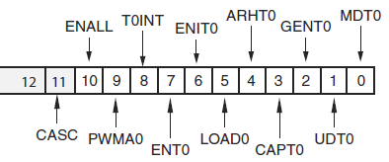
AXI Timers: Timer Control/Status Register 0
CASC – cascade mode
ENALL – Enable all timers when writing 1 to it to make ENT0=1 and ENT1=1.
PWMA0 – Enable PWM
T0INT – interrupt flag, write “1” to clear it
ENT0 – Enable Timer 0
ENIT0 – Enable Timer 0 interrupt
LOAD0 – load Timer 0 with value in TLR0
ARHT0 – Auto reload/hold Timer 0
CAPT0 – Enable external capture trigger
GENT0 – Enable external generate signal
UDT0 – Up/Down counting
MDT0 – Counter/Capture mode

Slide 57
AXI Timers Driver Functions, xtmrctr.h, xtmrctr.c under tmrctr_v3.c
int XTmrCtr_Initialize(XTmrCtr * InstancePtr, u16 DeviceId);
void XTmrCtr_Start(XTmrCtr * InstancePtr, u8 TmrCtrNumber);
void XTmrCtr_Stop(XTmrCtr * InstancePtr, u8 TmrCtrNumber);
u32 XTmrCtr_GetValue(XTmrCtr * InstancePtr, u8 TmrCtrNumber);
void XTmrCtr_SetResetValue(XTmrCtr * InstancePtr, u8 TmrCtrNumber, u32 ResetValue);
u32 XTmrCtr_GetCaptureValue(XTmrCtr * InstancePtr, u8 TmrCtrNumber);
int XTmrCtr_IsExpired(XTmrCtr * InstancePtr, u8 TmrCtrNumber);
void XTmrCtr_Reset(XTmrCtr * InstancePtr, u8 TmrCtrNumber);
XTmrCtr_Config *XTmrCtr_LookupConfig(u16 DeviceId);

Slide 58
AXI Timers Driver Functions, xtmrctr.h, xtmrctr.c under tmrctr_v3.c
void XTmrCtr_SetOptions(XTmrCtr * InstancePtr, u8 TmrCtrNumber, u32 Options);
u32 XTmrCtr_GetOptions(XTmrCtr * InstancePtr, u8 TmrCtrNumber);
void XTmrCtr_GetStats(XTmrCtr * InstancePtr, XTmrCtrStats * StatsPtr);
void XTmrCtr_ClearStats(XTmrCtr * InstancePtr);
int XTmrCtr_SelfTest(XTmrCtr * InstancePtr, u8 TmrCtrNumber);
void XTmrCtr_SetHandler(XTmrCtr * InstancePtr, XTmrCtr_Handler FuncPtr,
void *CallBackRef);
void XTmrCtr_InterruptHandler(void *InstancePtr);

Slide 59
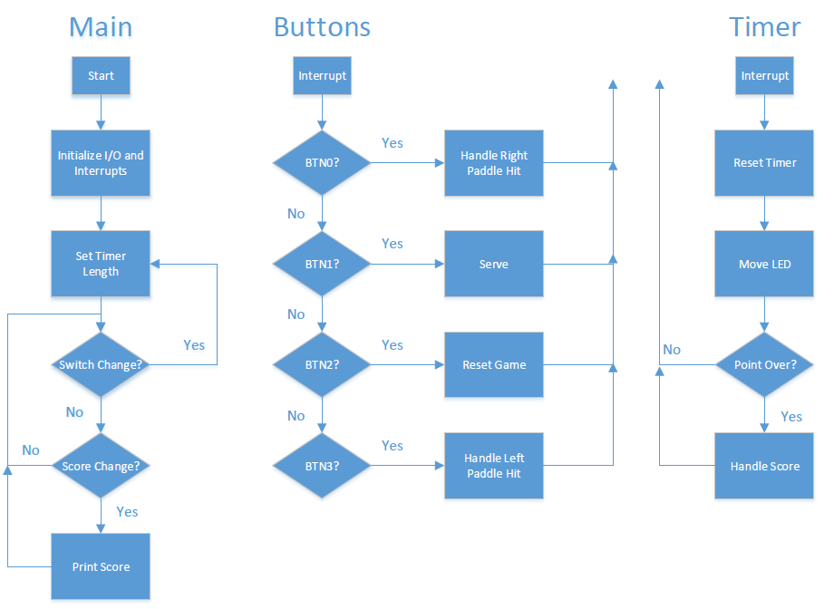
Lab #7 Interrupt-Driven LED Ping-Pong Game: David Mehl’s Code

Slide 60
Lab #7 Interrupt-Driven LED Ping-Pong Game: David Mehl’s Code
2 * pingPong.h
9
10 #ifndef PINGPONG_H_
11 #define PINGPONG_H_
12
14 #define PLAYER_1_PADDLE 0
15 #define PLAYER_2_PADDLE 3
16 #define SERVE_BUTTON 1
17 #define RESET_BUTTON 2
18
19 #define BLANK 0
20
21 typedef enum {
22 LEFT, RIGHT
23 } direction_t;
24
25 typedef enum {
26 NONE, EARLY, MISS, HIT
27 } hit_status_t;
28
29 typedef enum {
30 SERVE_LOCATION_RIGHT = -1, ZERO = 0, ONE, TWO, THREE, SERVE_LOCATION_LEFT
31 }location_t;
33 typedef enum {
34 NO_NEW_DATA, NEW_DATA
35 } game_change_t;
36
37 typedef enum {
38 STOP, GO
39 }game_state_t;
40
41 typedef struct {
42 direction_t direction;
43 location_t location;
44 uint32_t scorePlayer1;
45 uint32_t scorePlayer2;
46 hit_status_t hitPlayer1;
47 hit_status_t hitPlayer2;
48 game_change_t changed;
49 game_state_t state;
50 } GameStruct;
53
54 #endif /* PINGPONG_H_ */

Slide 61



Slide 62
Lab #7 Interrupt-Driven LED Ping-Pong Game: David Mehl’s Code
int main(void) {
47 gsptr->direction = RIGHT;
48 gsptr->location = THREE;
49 gsptr->scorePlayer1 = 0;
50 gsptr->scorePlayer2 = 0;
51 gsptr->hitPlayer1 = NONE;
52 gsptr->hitPlayer2 = NONE;
53
54 XTmrCtr *TimerInstancePtr = &timer;
55 int dip_check, dip_check_prev, status;
56
57 xil_printf("-- Start of the Program --\r\n");
58
59 XGpio_Initialize(&dip, XPAR_SWITCHES_DEVICE_ID);
60 XGpio_SetDataDirection(&dip, 1, 0xffffffff);
61
62 XGpio_Initialize(&push, XPAR_BUTTONS_DEVICE_ID);
63 XGpio_SetDataDirection(&push, 1, 0xffffffff);
64
65 dip_check_prev = XGpio_DiscreteRead(&dip, 1);
66 timerLoadValue = (ONE_LED * dip_check_prev) + TMR_BASE;
67 status = timerInit();
68 status = intcInit(&push);
69 if (status == XST_SUCCESS) {
70 #ifdef DEBUG
71 xil_printf("Successfully Initialized Timer\r\n");
72 #endif
73 } else {
74 #ifdef DEBUG
75 xil_printf("### Failed to initialize Timer ###\r\n"); #endif
77 return XST_FAILURE;
78 }
80 if (status == XST_SUCCESS) {
81 #ifdef DEBUG
82 xil_printf("Successfully Initialized Interrupts\r\n"); #endif
84 } else {
85 #ifdef DEBUG
86 xil_printf("### Failed to initialize Interrupts ###\r\n"); #endif
88 return XST_FAILURE;
89 }
91 resetGame(gsptr);
92 XTmrCtr_Start(TimerInstancePtr, TIMER_NUMBER);
94 // Check for switch changes and update timer accordingly
95 while (1) {
96 dip_check = XGpio_DiscreteRead(&dip, 1);
97 if (dip_check != dip_check_prev) {
98 timerLoadValue = dip_check * ONE_LED + TMR_BASE;
99 dip_check_prev = dip_check;
100 }
101 if (gsptr->changed != NO_NEW_DATA) {
102 xil_printf("Player 1: %d | Player 2: %d\r\n",
103 (unsigned int) gsptr->scorePlayer1,
104 (unsigned int) gsptr->scorePlayer2);
105 gsptr->changed = NO_NEW_DATA;
106 }
108 return 0; }
Notes:
David Mehl worked at Tesla as an intern and joined Greenhill after graduation

